Slide 1
Lecture 1
Introduction

Slide 2
Why Numerical Methods ?
Numerical methods aims to give a numerical solution to a mathematical problem
They are used whenever the mathematical problem is too complex or too lengthy to give a closed form solution
Numerical solutions are always approximations of the actual solution
Notes:
To start this course, let us discuss why such numerical methods are needed.
In fact numerical methods are used to produce numerical solutions of mathematical problems.
There are essentially two cases when you will use them.
First for problems where you do not know any mathematical closed form solution.
As you may recall form courses on mathematics you followed so far, such problems are in fact the norm. Only very few mathematical problems have an explicit closed form solution.
More realistic cases, such as we encounter them in engineering problems, will rapidly result in mathematical problems without any closed form solution.
A second case where numerical methods are used are situations where, even a closed form solution can be given, it is simply too cumbersome to use it or to lengthy to work it out.
Regardless why you will use numerical methods it is important to know and keep in mind that numerical methods will only produce approximations of the actual mathematical solution.
During this course, we will dedicate a major part of our time to learn how we can evaluate the quality of such approximations. In particular we want to be able to estimate how far away our approximation is from the actual solution.
To learn how to give an upper boundary of the difference between our approximation and the actual mathematical solution, even when we don’t know this solution, is one of the key competence we will learn.

Slide 3
Which Problems Will Be Covered?
None linear equations
Systems of linear equations
Regression and interpolation
Introduction to machine learning
Numerical differentiation
Numerical Integration
Initial value problems
Notes:
During the course we are going to learn numerical methods able to handle a wide variety of common engineering mathematical problems.
There will be seven major topics which are:
None linear equations
Systems of linear equations
Regression and interpolation
Introduction to machine learning
Numerical differentiation
Numerical Integration
And Initial value problems
For each topic we will see major families of numerical methods and some representative methods.
Besides the methods themselves, we will always focus on learning how we evaluate the quality of the numerical approximation produced by these methods.
We will learn that the way to assess the quality of an approximation is in fact quite method independent and can be applied to a very wide variety of numerical methods.
But more on this later.

Slide 4
What Are Numerical Methods?
Numerical methods are algorithms
Precise set of rules to follow
Generate a numerical approximation of the mathematical problem
Do not tell how good/poor is the approximation
To give a complete answer an estimation of the error of the approximation has as well to be determined
Notes:
What are numerical methods?
A numerical method has actually two distinct components.
First of all there is an algorithm. Algorithms are a set of precise rules one has to follow to produce the numerical approximation.
These algorithms will generate a numerical approximation.
However, they will not be able to tell anything about how good or poor this approximation is.
That is why a second component is always needed beside the algorithm: a method to estimate the error between the generated approximation and the exact mathematical solution.
Let me insist that, without this error estimation, all the work done in the frame of an algorithm is pointless and is not better than giving a random guess of the searched solution.

Slide 5
Most Algorithms Are Iterative
x_{o}
x₂
x₁
Algorithm
Notes:
As we will see during the semester, most numerical algorithms are iterative.
This means they have to be fed with an initial guess xo of the solution we search for.
They will then use this guess to generate an improved approximation x1 of the solution.
The iteration can go on by using this approximation x1 and running it again through the algorithm to improve it further to x2
One can go on like this as long as desired.
The algorithm itself has no in-built rule to tell when one should stop.

Slide 6
Quality Control of Answer
Algorithm
x_{i}
x_{i+1}
Error < TOL
Error > TOL
Notes:
To decide at which moment one can stop iterating further the algorithm, one must be able to estimate the error between the approximation and the exact mathematical solution.
We will often refer to this step as the “Quality control step”.
If we are able to estimate the error, then we can decide if we want to proceed or not with our iterations. If the error falls below the desired procession then we can stop.
If the error is still larger, we need to continue iterating.
How small the target precision is will depend on the specific problem you solve and especially on why you are solving it.
Maybe you are a mechanical engineer that has to calculate a specific dimension of a mechanical part to fulfill the design specification of your problem. These specification require for example that you know this critical dimension with a precision better than 0.1 mm.
Or maybe you are an electrical engineer that has to simulate a circuit in order to determine the value of some components with a tolerance below 1%.
You see that there is no universal value for this precision. It is problem specific and as such is an input to the problem we want to solve numerically.
Contrary to the algorithm itself, the quality control step is very tricky. It is almost an art.
As we will learn, there is not one single simple way to do it. It will often be a combination of various analysis that can give us the needed confidence that indeed we reached an approximation with an error less than the precision we aim for.
In summary we can say that the application of the algorithm is simply a matter of using correctly a numerical software, whereas the correct analysis of the error on the produced approximation is a complete engineering analysis problem.

Slide 7
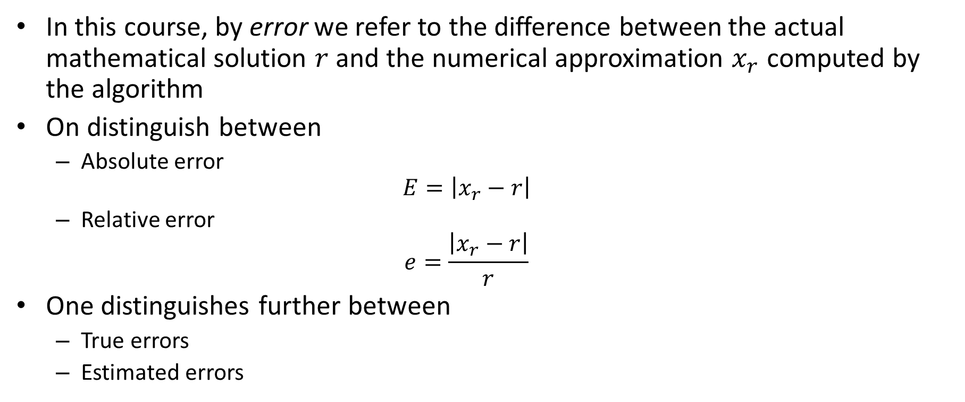
Errors
In this course, by error we refer to the difference between the actual mathematical solution $r$ and the numerical approximation $x_{r}$ computed by the algorithm
On distinguish between
Absolute error $E=\left|x_{r}−r\right|$
Relative error $e=\frac{\left|x_{r}−r\right|}{r}$
One distinguishes further between
True errors
Estimated errors
Notes:
What do we exactly mean by error?
During this course we will refer by error the difference between the exact mathematical solution r and the approximation xr produced by an algorithm.
This error can be either measured as an absolute error or as a relative error.
The type of engineering problem on which you apply the numerical method will usually dictate which way is more appropriate to use. But most often the relative error is more appropriate.
For example imagine you have to calculate a distance with a precision of say 1 mm.
Is this challenging?
Well, that will depend on how long this distance is.
Determining the distance between earth and moon to a precision of 1mm is indeed very challenging.
Determining the distance between two legs of a table will be much less challenging.
If you specify this precision in a relative error you will see that it becomes fair to compare the two examples and it will become clear right away that the first one is much more demanding than the second one.
A further important distinction, which is source of many confusion among students starting to learn about numerical methods, is the distinction between true errors and estimated errors.

Slide 8

True Errors
True errors are the difference between the actual mathematical solution $r$ and the numerical approximation $x_{r}$
For a real situation the true error is never known as the true solution $r$is unknown
Notes:
True errors are the exact difference between the exact mathematical solution and the approximation produced by the numerical algorithm.
Let me insist that in real situations the true error is never known. To calculate the true error you would have to know the true solution.
But if you know the true solution you will obviously not use a numerical method to solve your problem.

Slide 9
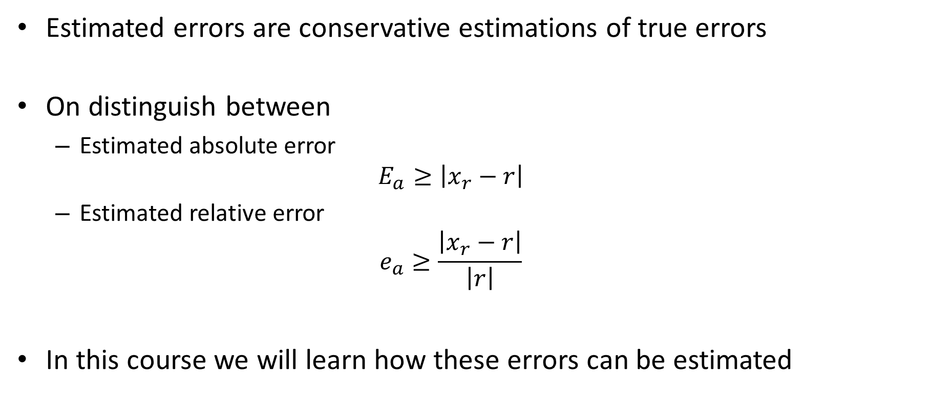
Estimated Errors
Estimated errors are conservative estimations of true errors
On distinguish between
Estimated absolute error $E_{a}≥\left|x_{r}−r\right|$
Estimated relative error $e_{a}≥\frac{\left|x_{r}−r\right|}{\left|r\right|}$
In this course we will learn how these errors can be estimated
Notes:
If true errors are never known, one has to estimate these errors.
And that is exactly what are estimated errors.
Estimated errors are conservative estimations of true errors.
On distinguish between estimated absolute error and estimated relative error.
Again the particular engineering problem you deal with will dictate which one is more appropriate to use.
You will see that major part of the time in this course is dedicated to learn how we can estimate errors.

Slide 10
Source of errors
Errors in mathematical modeling
Blunders (bugs)
Errors in inputs
Round-off errors
Truncation errors
Specific to numerical methods
Notes:
Now we know what are errors. But why do we have errors?
Imagine you have to develop a mathematical model to solve a certain engineering problem.
While doing this task you may do several errors
For example you may do errors in the model itself. For example errors in mathematical calculations or more commonly, and almost not avoidable, your model is in fact only an approximation of the true situation.
Let us imagine you have developed your model and want now to solve it with a numerical algorithm.
You may introduce bugs once you implement the algorithm.
Or there may be errors in the parameters you need to feed your model.
You can imagine several more sources of errors.
But let us imagine at this stage you have developed an ideal mathematical model, implemented completely bug free your algorithm and you are able to feed it with unlimited precision.
Even if you do all this in an ideal and perfect way, there will always remain two sources of errors that are due to the fact you use a numerical algorithm:
round-off errors and truncation errors.
In the reminder of this semester we will learn how we can handle these unavoidable errors and how we can estimate them.
We will not be interested in the other sources of errors which are not specific to numerical methods.

Slide 11
Summary
Numerical algorithms
Compute a numerical approximation of a mathematical problem
Are in general iterative
Do not provide an estimation of how good/bad the approximation is
Numerical algorithms comes with two specific sources of errors
Round-off errors
Truncation errors
Strategies to estimate the error of a numerical approximation will have to be developed

